Slide 1
Evolutionary Symbolic Regression of the Deviation of Land-Surface Temperature by Year
Mike Dean

Slide 2

Objective
To identify a pattern in global temperature if one exists.

Slide 3

Data
Obtained from Berkley Earth, dedicated to studying climate change and reduce greenhouse gas emissions.
The values represent the deviation from the average land-temperature recorded between Jan 1951 and Dec 1980: 8.70°C +/- 0.06°C.
Deviations were measured for all years between 1753 and 2013.

Slide 4
Methods
Using Clojush/PushGP evolution was performed on the numerical value of the year (i.e. 1851 would be 1851.0).
Push was given random sequences of years to train a function to produce the annual deviation which was then tested on another random sequence of years.

Slide 5
Code
(defn train [n i]
(def train-data (rand-nth (partition n (shuffle data1))))
(def test-data (rand-nth (partition i (shuffle (remove (set train-data) data1)))))
(def argmap-train
{..
:ultra-probability 1
:ultra-alternation-rate 0.01
:ultra-alignment-deviation 1
:ultra-mutation-rate 0.05
:return-simplified-on-failure true
The function above takes two inputs which randomize the dataset and creates two partitions of the data, the first is used to develop a program while the second set is what the program is tested on to determine the error.

Slide 6
(define-registered
float_log
(fn [state]
(if (not (empty? (:float state)))
(push-item (keep-number-reasonable
(plog (stack-ref :float 0 state)))
:float
(pop-item :float state))
state)))
(define-registered
float_ex
(fn [state]
(if (not (empty? (:float state)))
(push-item (keep-number-reasonable
(Math/pow Math/E (stack-ref :float 0 state)))
:float
(pop-item :float state))
state)))
(define-registered
float_cbrt
(fn [state]
(if (not(empty? (:float state)))
(push-item (keep-number-reasonable
(Math/cbrt (stack-ref :float 0 state)))
:float
(pop-item :float state))
state)))
(ns Regression.operators
(:use [clojush.pushstate]
[clojush.util])
)
(defn ps
"Protected square root; returns 0 if the radicand is less than zero."
[radicand]
(if (> 0 radicand)
radicand
(java.lang.Math/sqrt radicand)))
(defn plog
[num]
(if (>= 0 num)
0
(java.lang.Math/log num)))
(define-registered
float_sqrt
(fn [state]
(if (not (empty? (:float state)))
(push-item (keep-number-reasonable
(ps (stack-ref :float 0 state)))
:float
(pop-item :float state))
state)))
Various mathematical operations allowed on the input values.

Slide 7
:error-function (fn [program]
(doall
(for [[input output] train-data]
(let [state (run-push program
(push-item input :auxiliary
(push-item input :float
(make-push-state))))
top-float (top-item :float state)]
(if (number? top-float)
(abs (- top-float output))
1000.0)))))
:atom-generators (list (fn [] (lrand 15))
'in
'float_div
'float_mult
'float_add
'float_sub
'float_div
'float_log
'float_ex
'float_tan
'float_sin
'float_cos
'float_sqrt
'float_cbrt
)})
Definition of the error function which is the difference of the output of the evolved program and the y-value of the data.

Slide 8
These functions take the best program and assess the error on the test cases, i.e. the cases which did not train the program.
(def best-program (:program (pushgp argmap-train)))
(defn test-program [x]
(:float (run-push (replace {'in x} best-program) (make-push-state)))]
)
)
(defn test-all-error [] (/ (reduce + (map abs (vec (map - (map last data1) (flatten (map test-program (map first data1)))))))
(count (map abs (vec (map - (map last data1) (flatten (map test-program (map first data1))))))))
)

Slide 9
Results
(-7.2810737922891064 -16.592578541392385 float_sin float_div float_div float_tan float_tan float_cos float_sqrt float_ex float_sin in float_sqrt float_sin float_sin float_sin float_sin float_sqrt float_sin float_mult float_tan float_tan float_tan 1.905420410743711 float_cbrt float_div float_tan float_sin -5.537283407645102 float_tan float_log float_tan float_tan float_tan float_tan float_add float_tan)

Slide 10
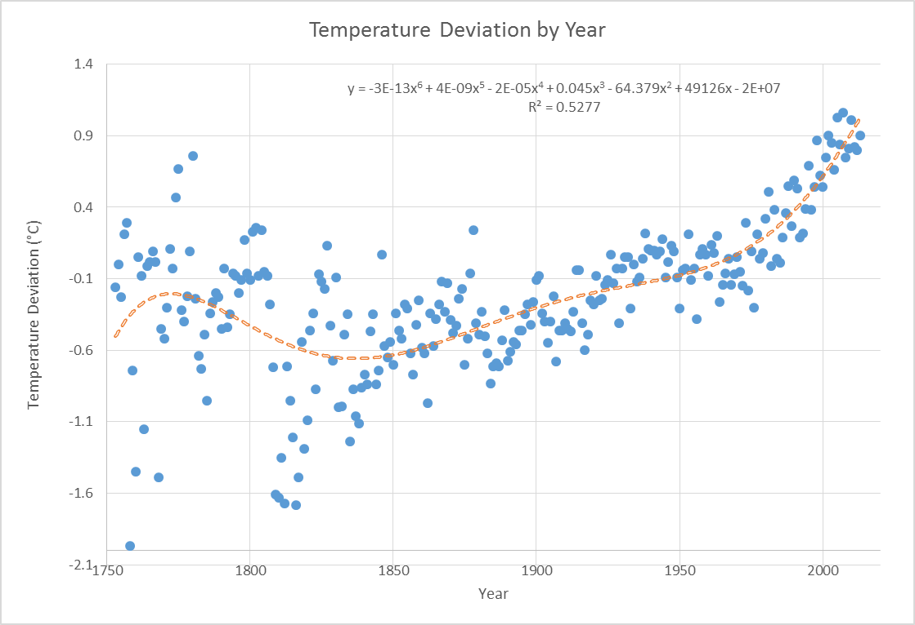

Slide 11
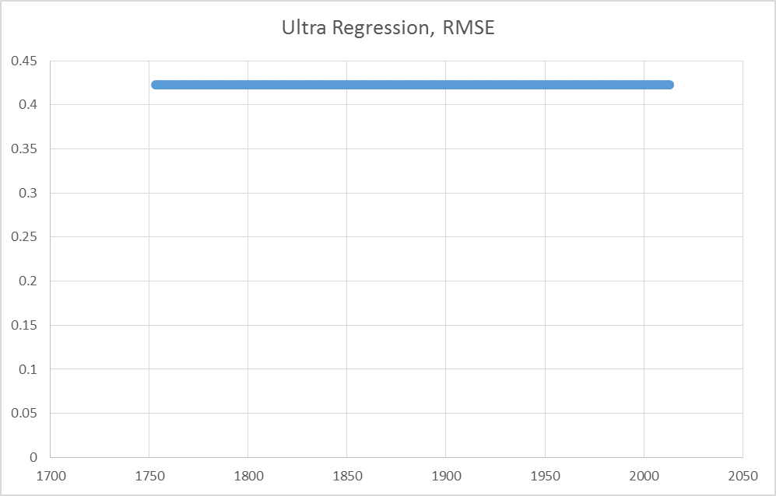

Slide 12
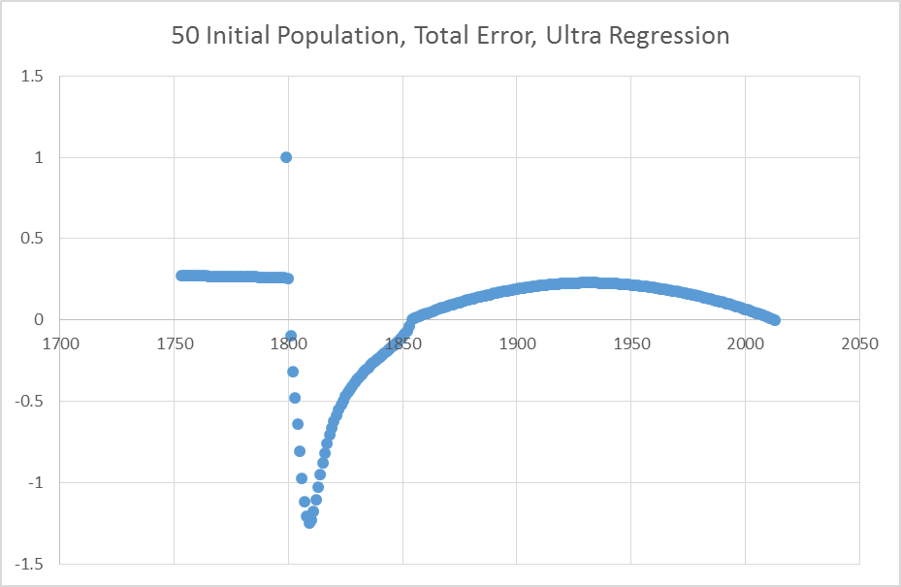

Slide 13
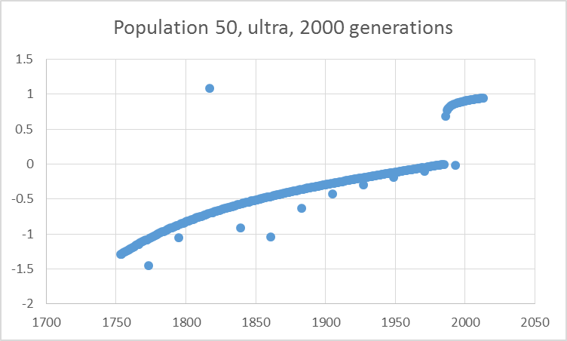

Slide 14
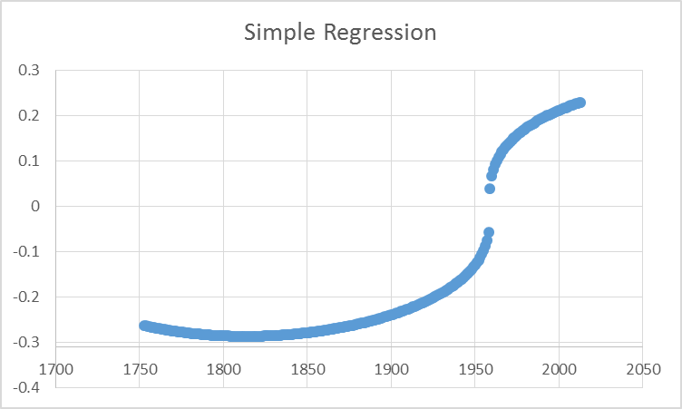

Slide 16


Slide 17
Outcome
Is there a pattern?
2015: 8.88°C = 47.98°F

